Slide 1
Experiment Summary
Experiment Name
: 2018-06-18 2377-009 TPP1 qPCR Run 2
Experiment Type
: Standard Curve
File Name
: 2018-06-18 2377-009 TPP1 qPCR Run 2.eds
Date Modified
: Mon Jun 18 16:56:12 EDT 2018
Date Created
: Mon Jun 18 13:08:16 EDT 2018
Run Started
: Mon Jun 18 16:39:45 EDT 2018
Run Finished
: Mon Jun 18 18:12:04 EDT 2018
Run Duration
: 92 minutes 19 seconds
User
:
Number of Wells Used
: 96
Number of Wells with Results
: 96
Instrument Name
: 278870909
Date Printed
: Jun 19, 2018
2018-06-18 2377-009 TPP1 qPCR Run 2

Slide 2
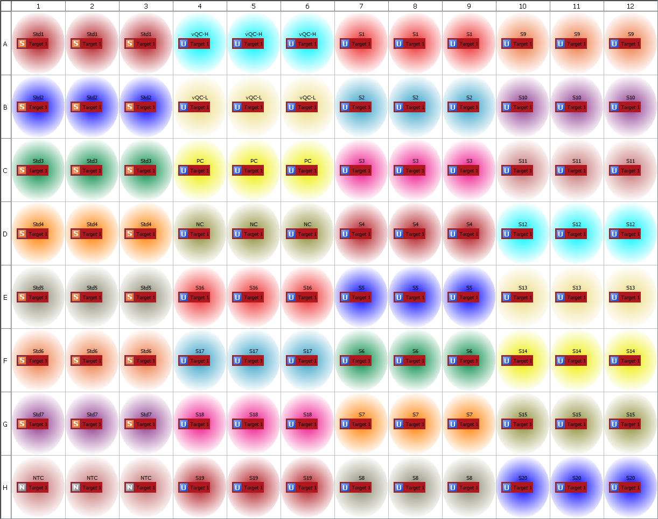
Plate Layout
2018-06-18 2377-009 TPP1 qPCR Run 2

Slide 3
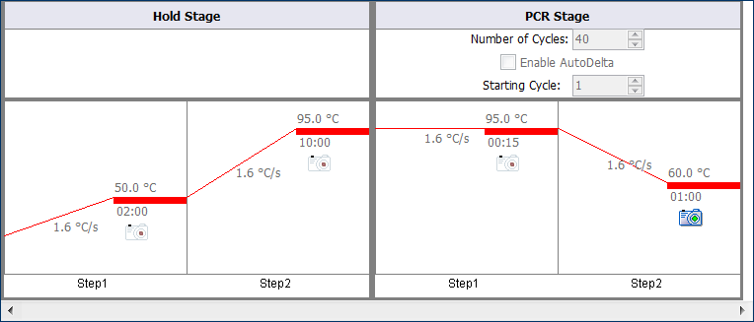
Thermal Method
2018-06-18 2377-009 TPP1 qPCR Run 2

Slide 4
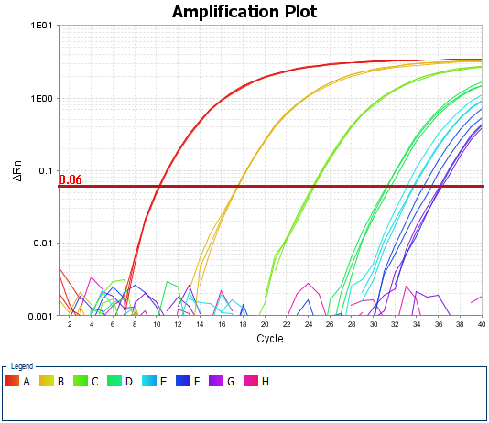
Amplification Plot
2018-06-18 2377-009 TPP1 qPCR Run 2

Slide 5
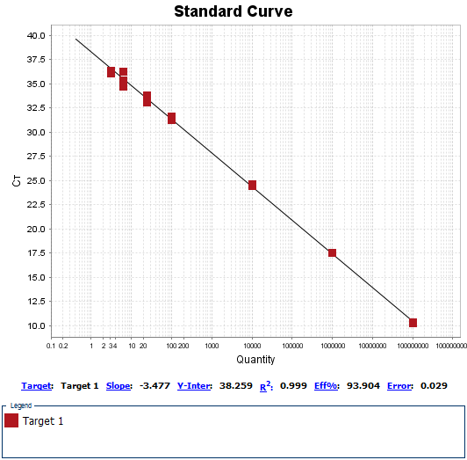
Standard Curves
2018-06-18 2377-009 TPP1 qPCR Run 2

